Slide 1

DDS Analytics
Your source for unraveling the signal within the noise

Slide 2




About Us
We are a team of 3 diligent data scientists who are focused on accurate, timely, and precise analysis of your desired subject matter.
Team TAM:
Andy Heroy – Graduate Student at SMU. Accapella singer extraordinare.
Martin Garcia – Graduate Student at SMU. Avid bookworm.
Tej Tenmattam - Graduate student at SMU. Master of scheduling and working ahead of deadlines.

Slide 3
You take away our top 20 employees and overnight we become a mediocre company”
- Bill Gates

Slide 4

Exploratory Data Analysis
What are the main factors leading to attrition from our company. Our findings revolve around
Overtime
Monthly Income
Total Working Years
Job Role
Age

Slide 5
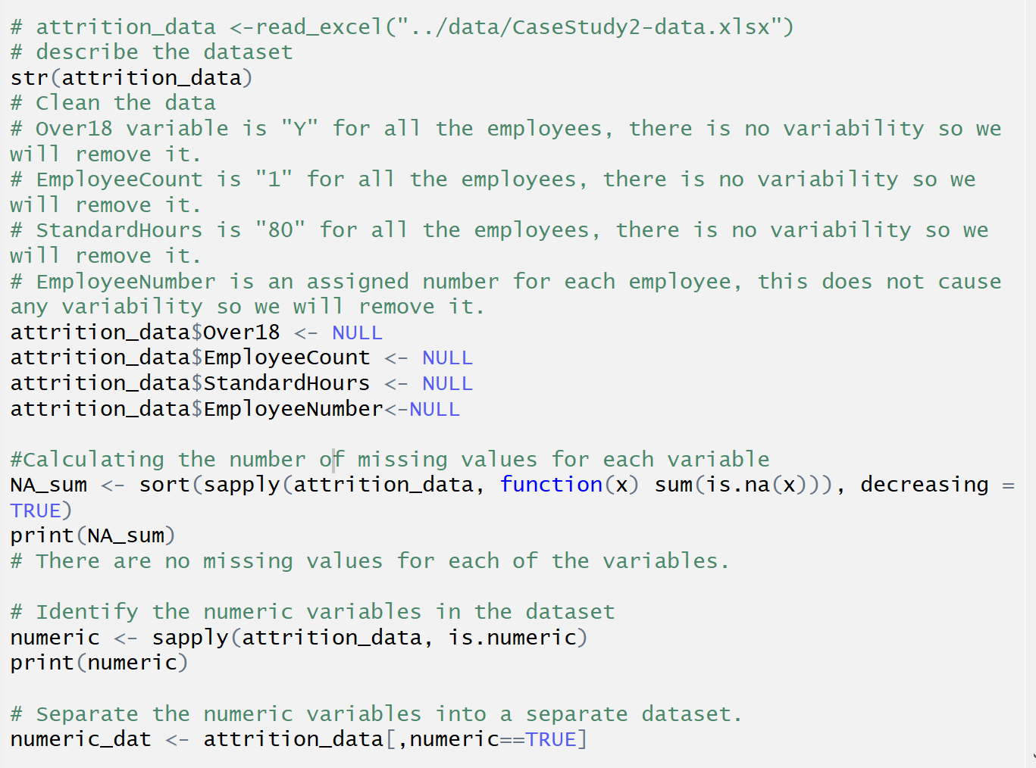
Data Cleaning pre - analysis
Removed the following columns
Over18
No variation
Employee Count
No variation
Standard Hours
No Variation
Employee number
Irrelevant to attrition analysis
For initial analysis we wanted to look at only numeric variables
Look for Null Values

Slide 6
Plan of attack for solving attrition rate factors
Confirm most important variables within the given datasets through multiple approaches
Approach
Scatter plot and Correlation Matrix to find significant variables
Decision Tree Analysis
Stepwise Regression
What does each analysis technique tell us are the most statistically significant variables? Do they match?

Slide 7
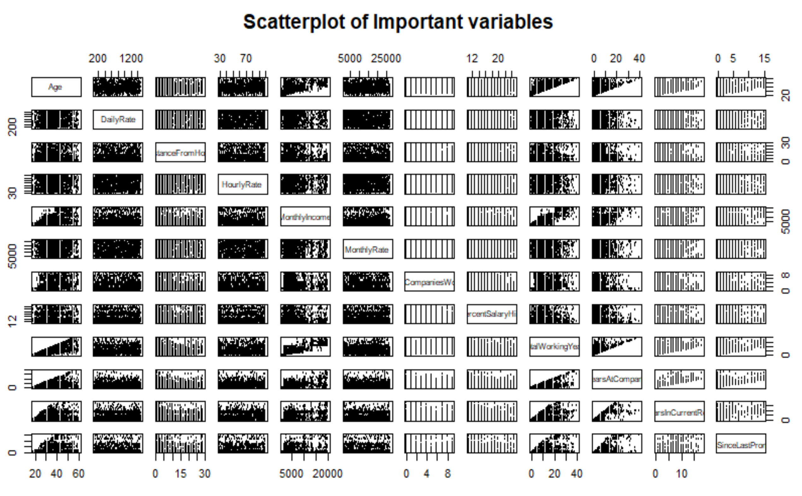
Scatterplot Matrix
Numeric variables
Chart
Analysis
Scatterplot does not yield a lot of clarity as to importance to results.
Scaling is very different
23 different variables makes it a bit crowded.
Correlation might be a better attempt

Slide 8
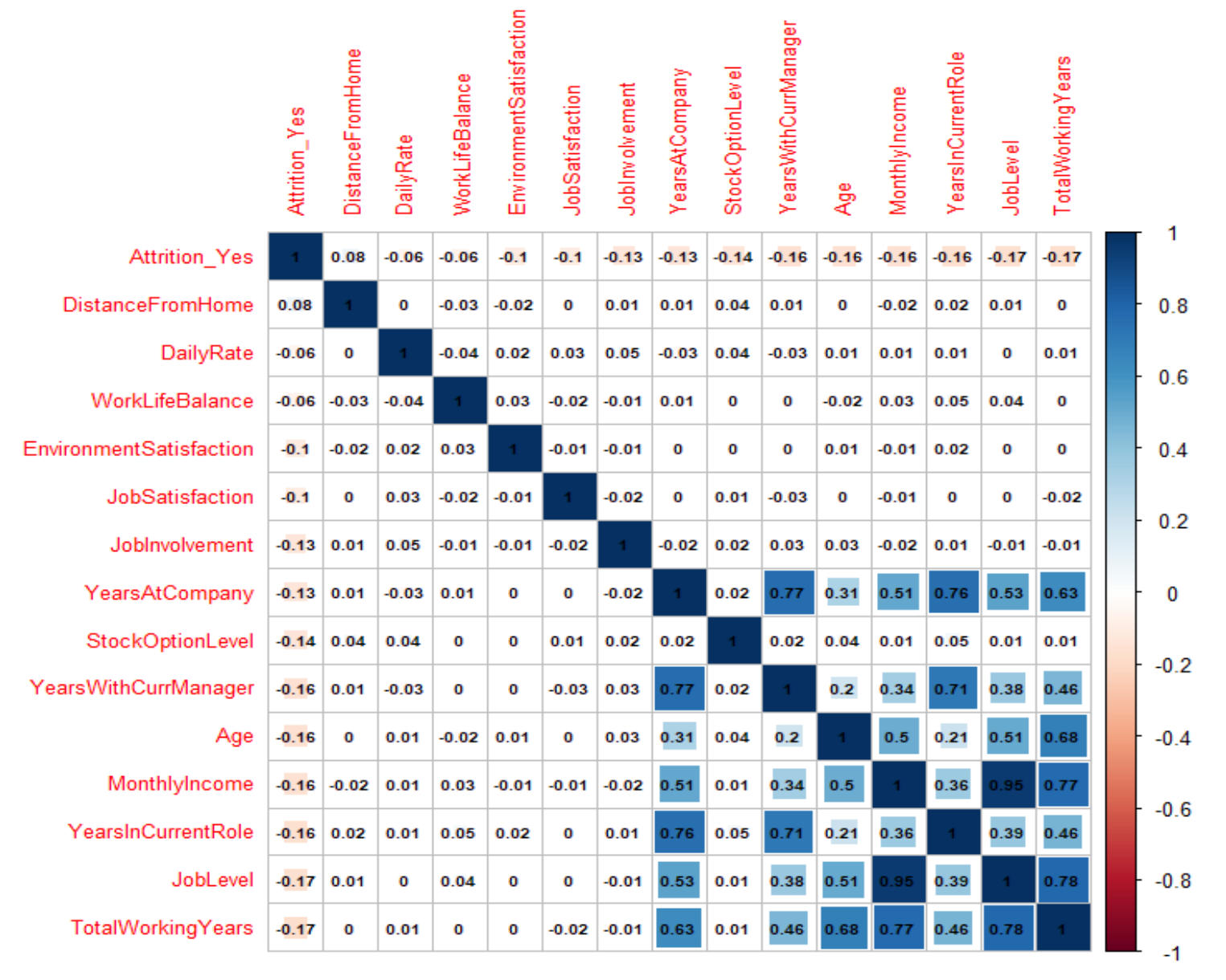
Correlation Plot Matrix
Correlation by Yes attrition
Findings
Only look at Numerical Data
The Yes data was coded as 1 within the dataset. No values were removed to focus on largest correlation of attrition variables.
Highest Correlation factors (bottom right) were
Years in Current Role
Job Level
Total Working Years
Lowest
Distance from home
Daily rate
Work Life Balance

Slide 9
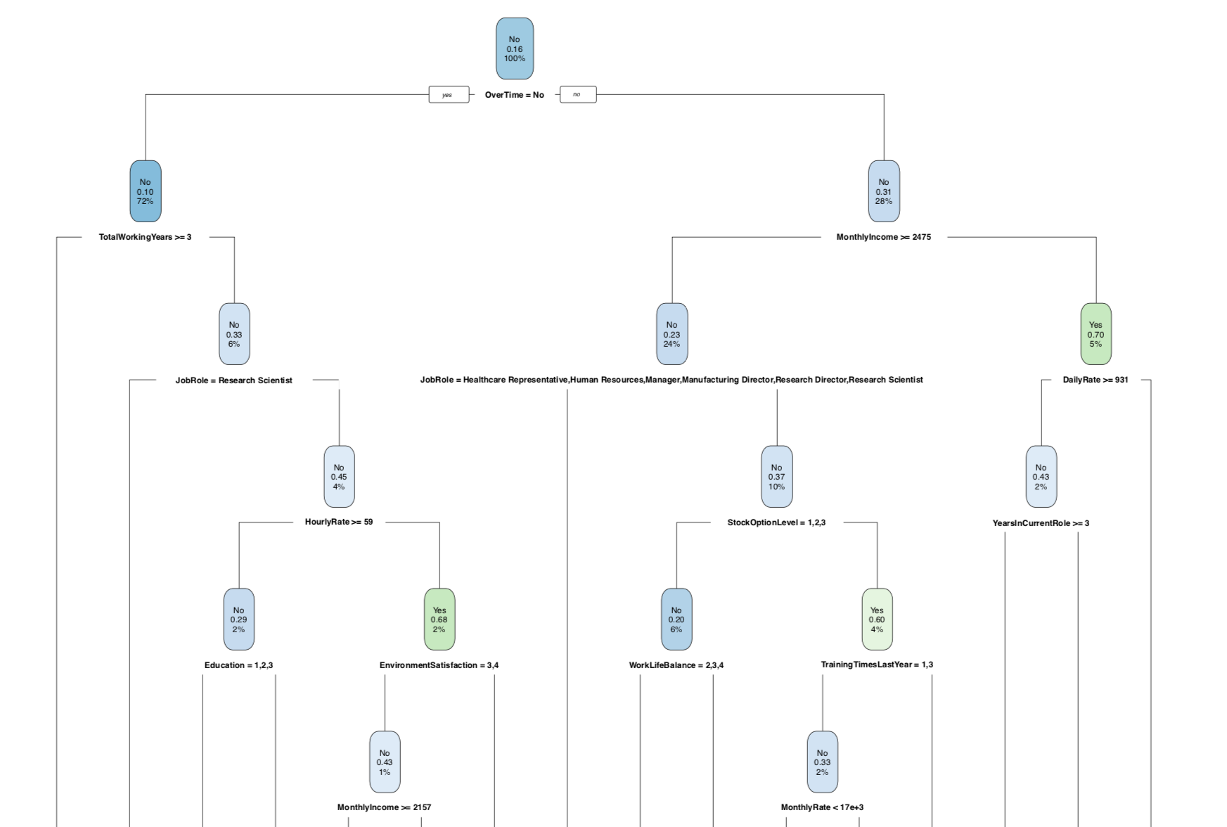
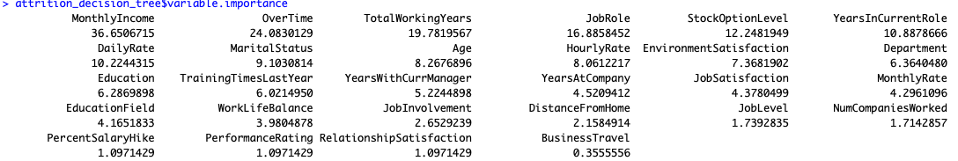
Automatic Variable Selection
Decision Tree Model
Supervised learning method for non-linear relationship mapping
Results
The top influential variables are
Overtime
Monthly Income
Total Working Years
Job Role

Slide 10
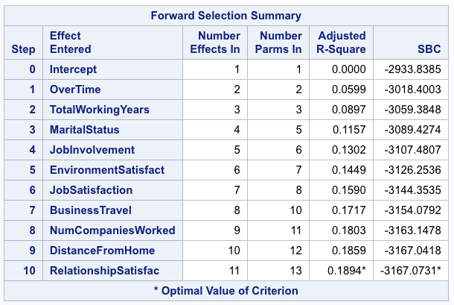
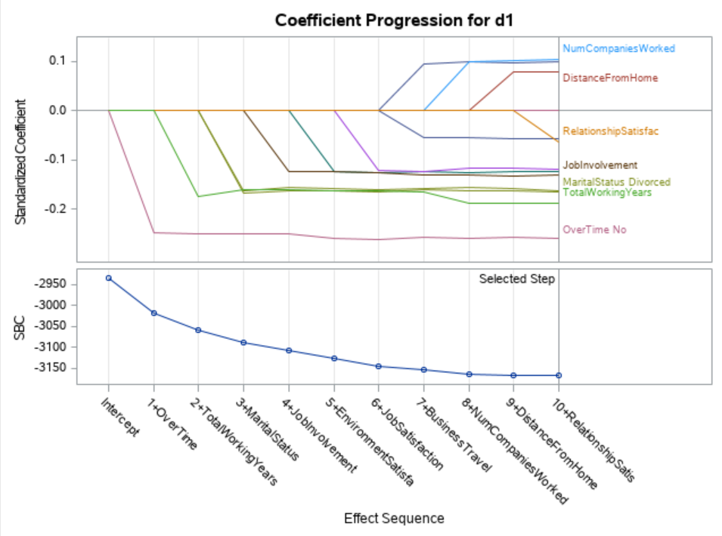
Automatic Variable Selection
Forward selection Model
Supervised learning method for non-linear relationship mapping
Results
The top 3 influential variables are
Overtime
Total Working Years
Marital Status

Slide 11
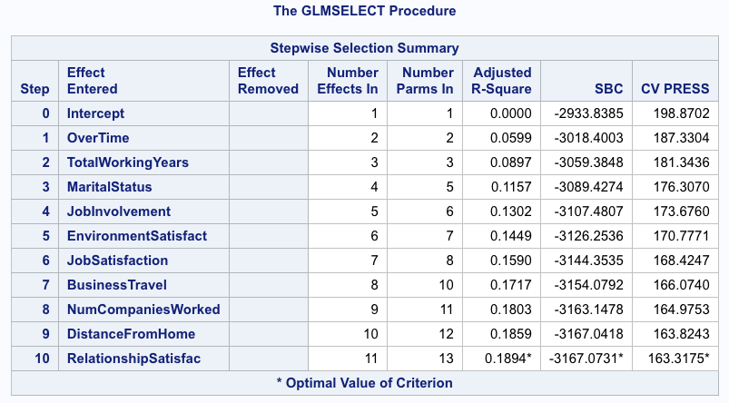
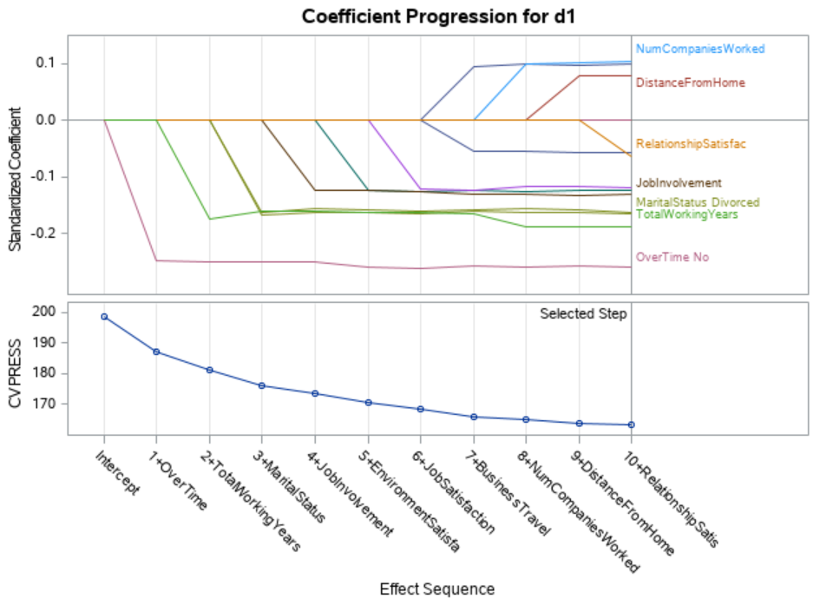
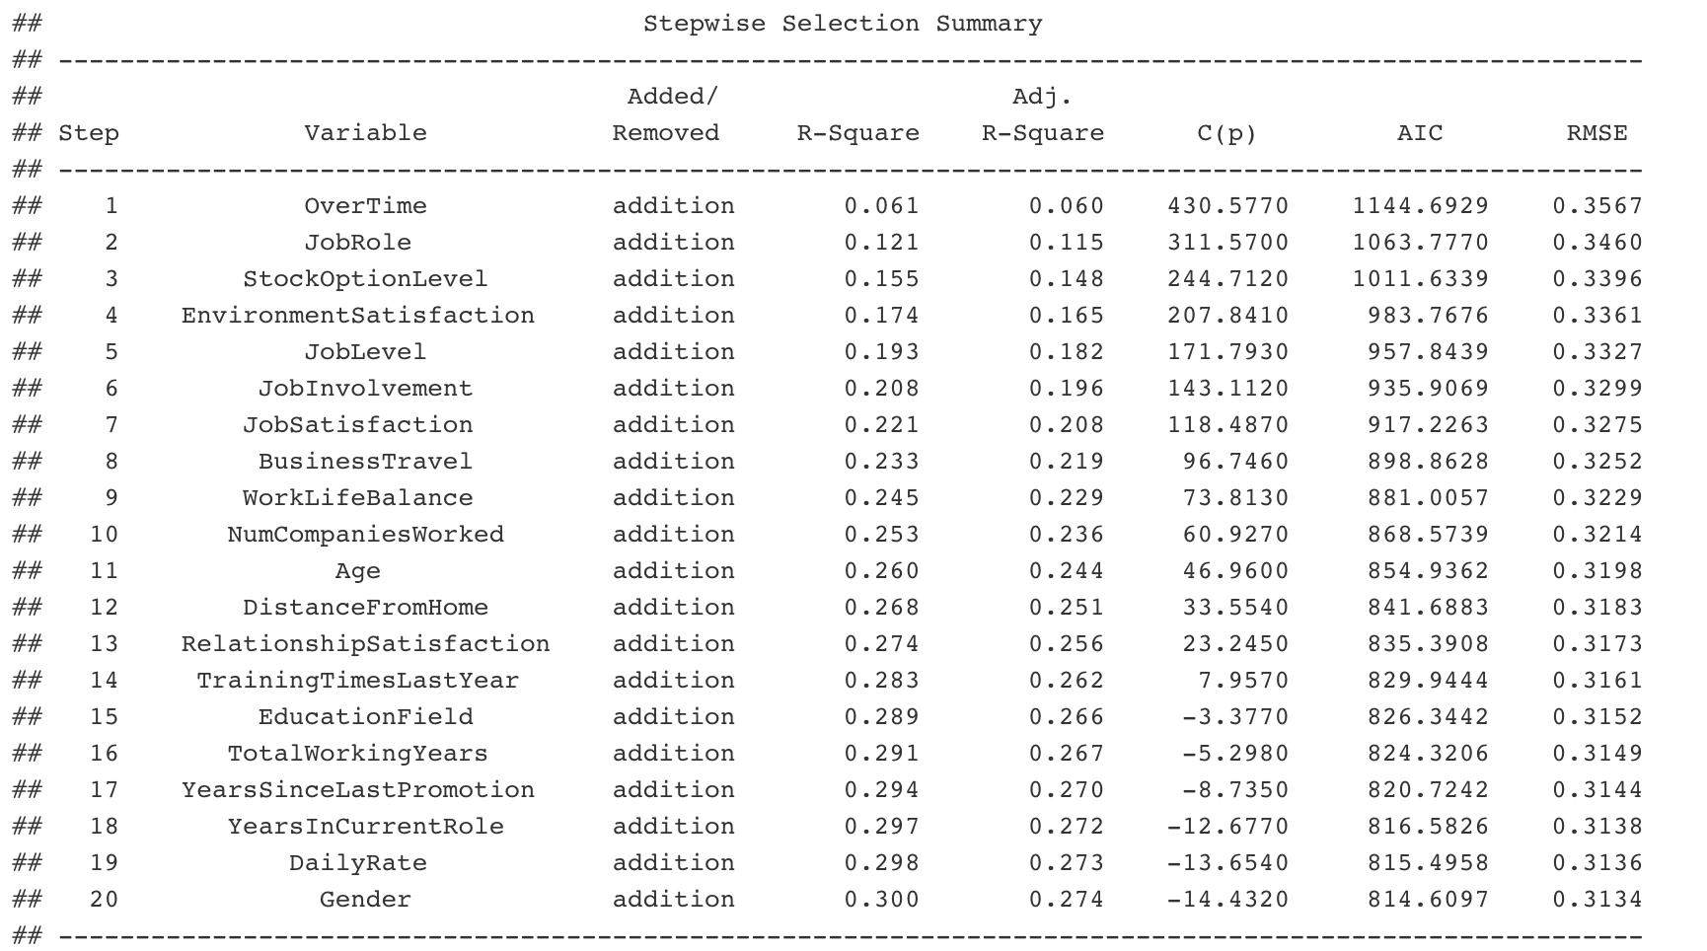
Automatic Variable Selection
Stepwise selection Model
Supervised learning method for non-linear relationship mapping
Results
The top 3 influential variables are
Overtime
Total Working Years
JobRole

Slide 12
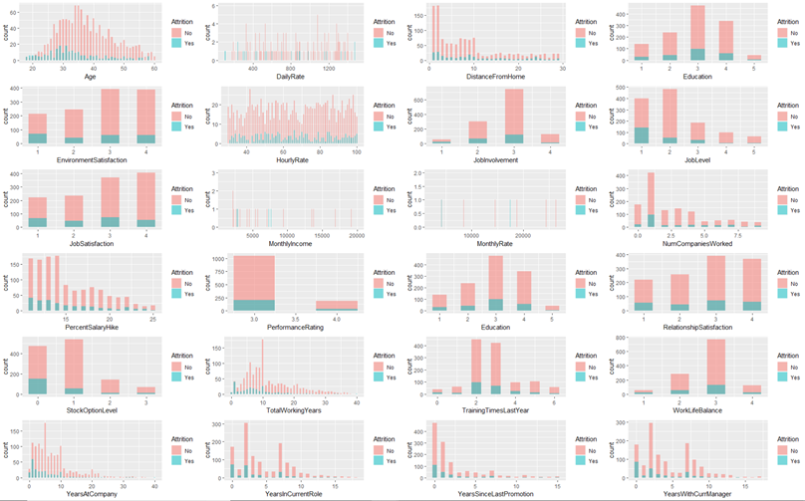
Histograms
Histogram for Attrition against total quantifiable values
Points of Interest
•To be taken into consideration, the volume of those with no attrition is substantially higher
•Distance from home
•Total Working Years
•Years at Company

Slide 13
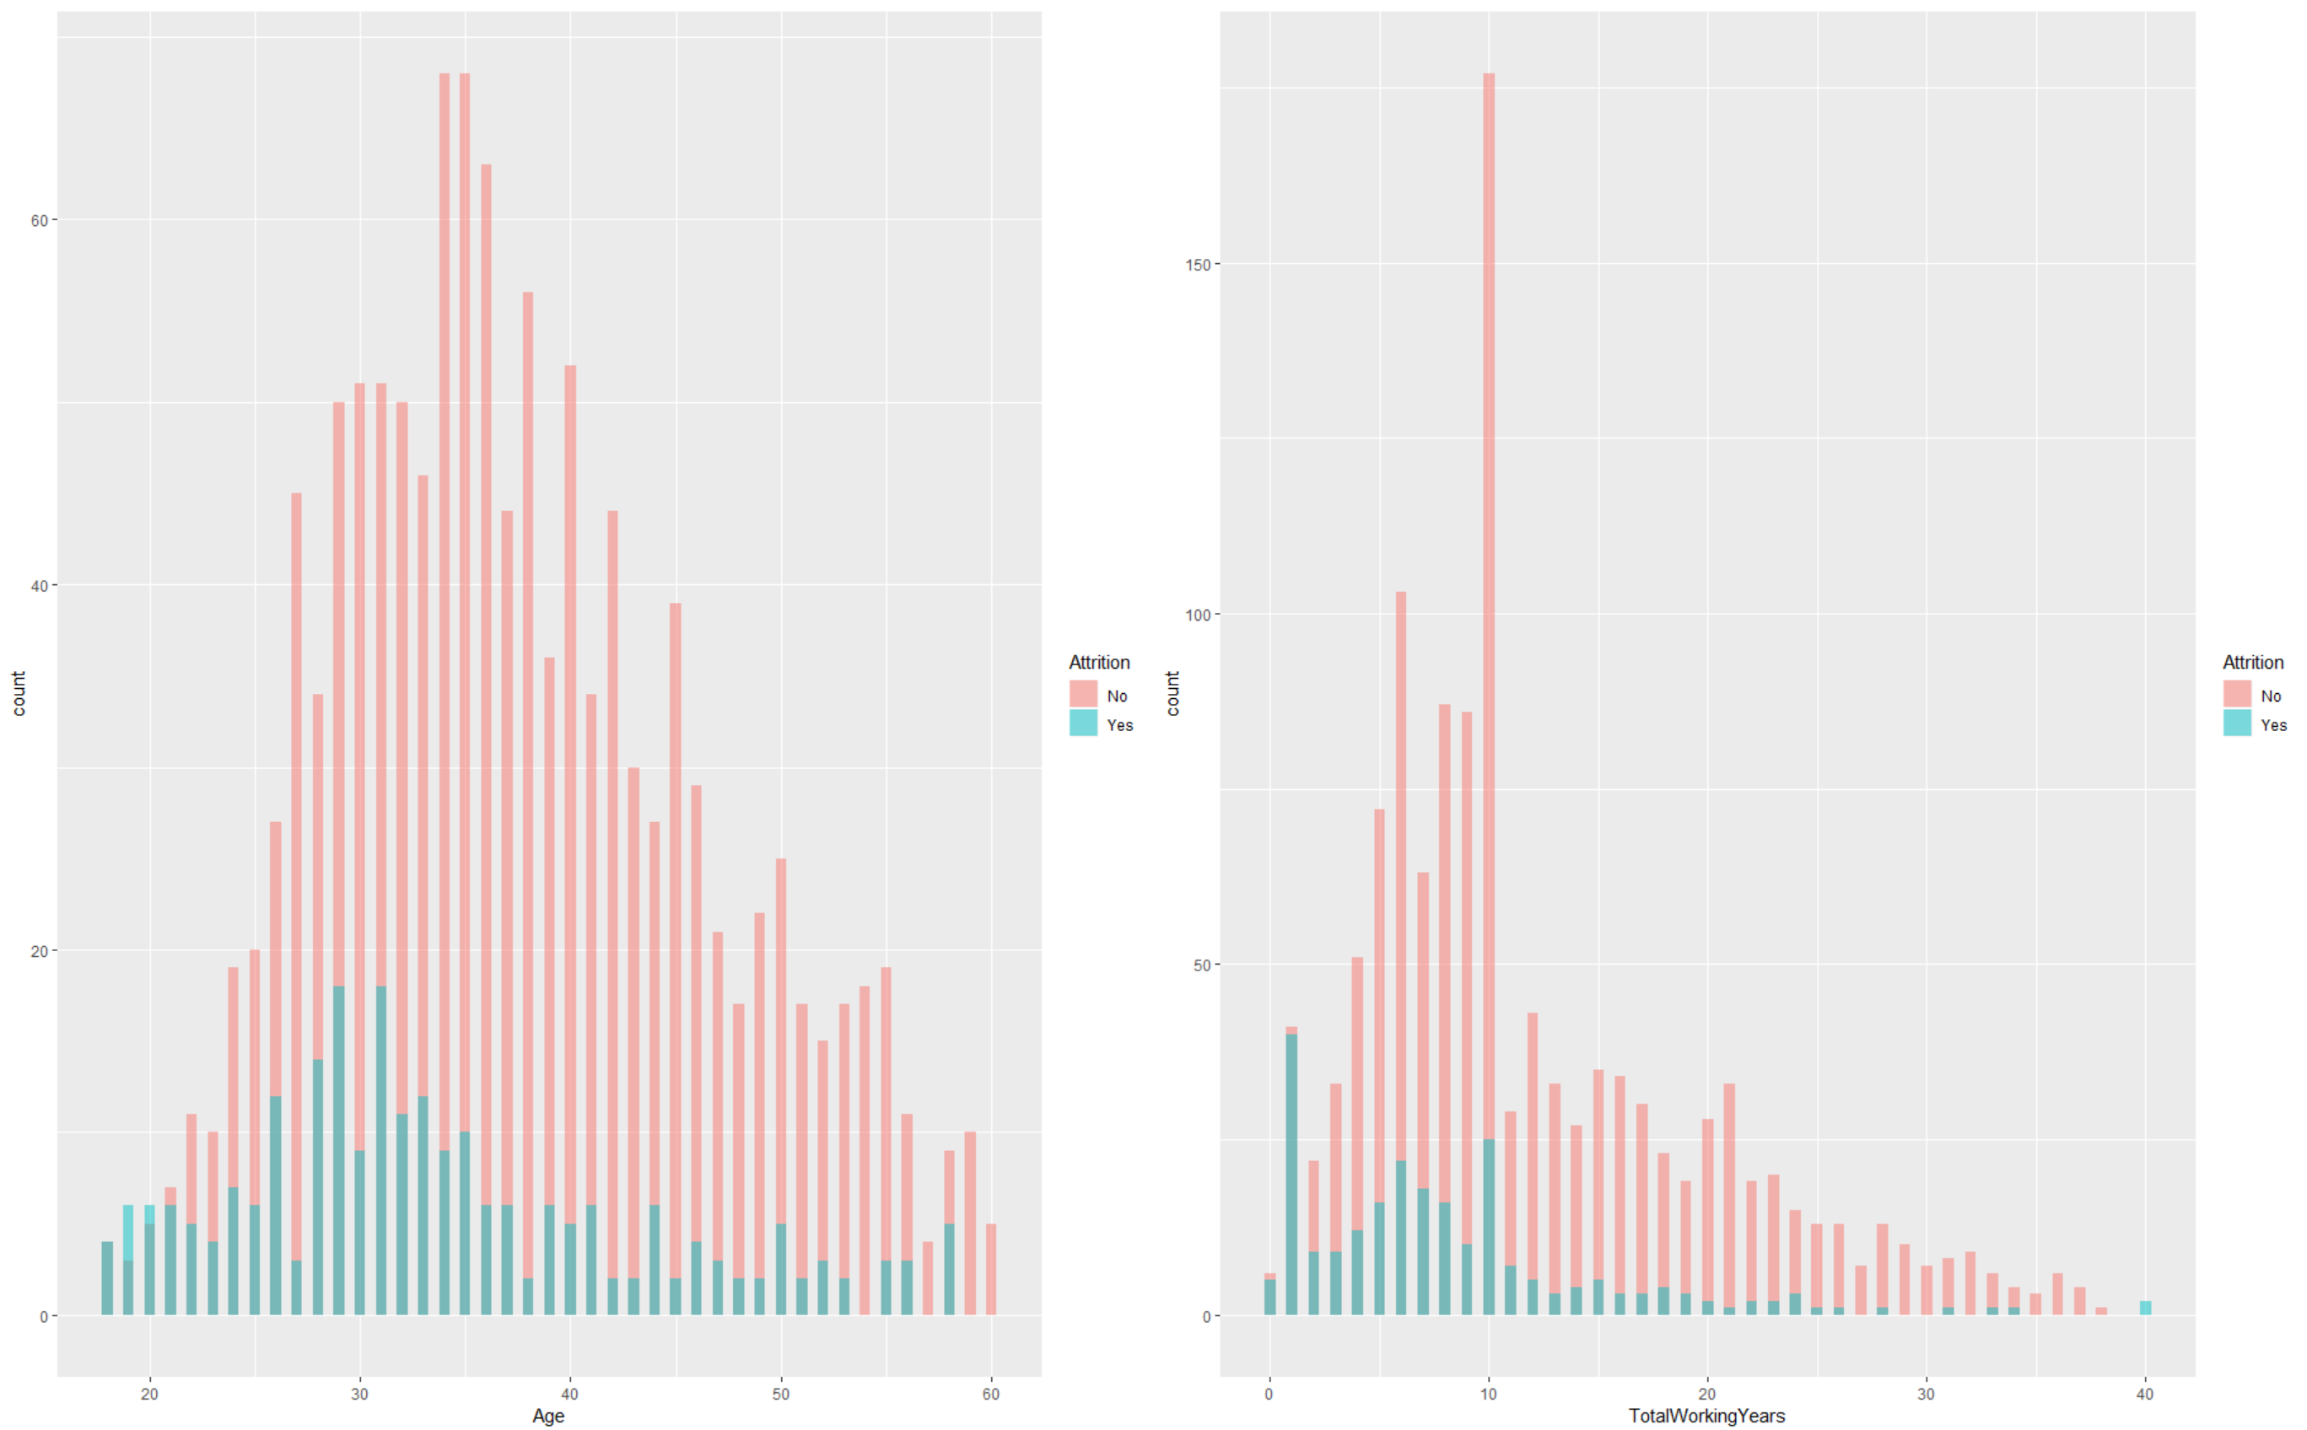
Closer look at our main factors
Histogram for Age and Total Working Years

Slide 14
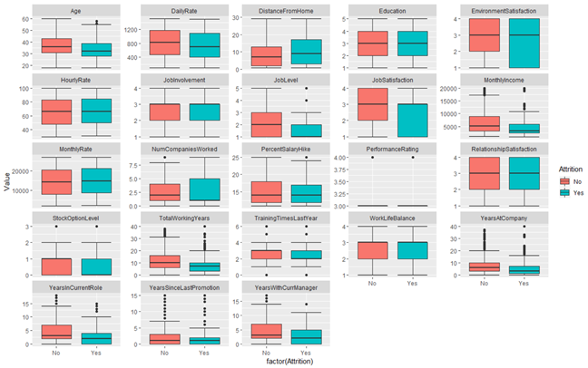
Box Plots
Box Plots for Quantified Variables
Box Plot Analysis
•Most box plots showed similar distributions categorized by attrition and age against quantifiable variables
•What does that mean? Education for example.
•Job levels – Most with attrition had lower job levels
•Job Satisfaction – Those with attrition were skewed towards the bottom
•Monthly Income – No attrition translates to higher average income
•Stock Options – Low priority, skewed towards 1 level of importance

Slide 15
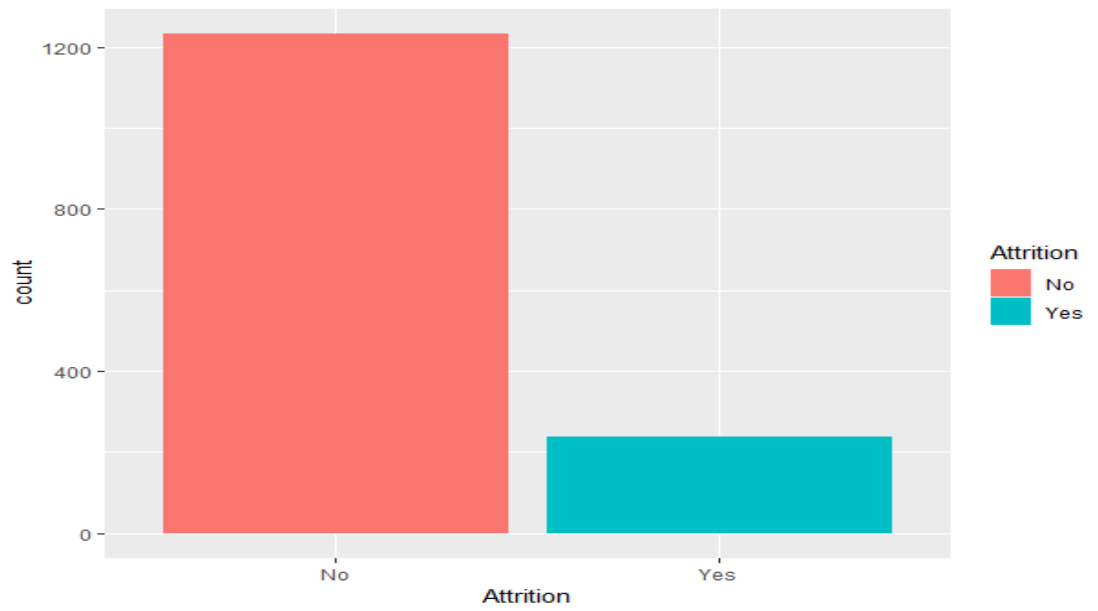
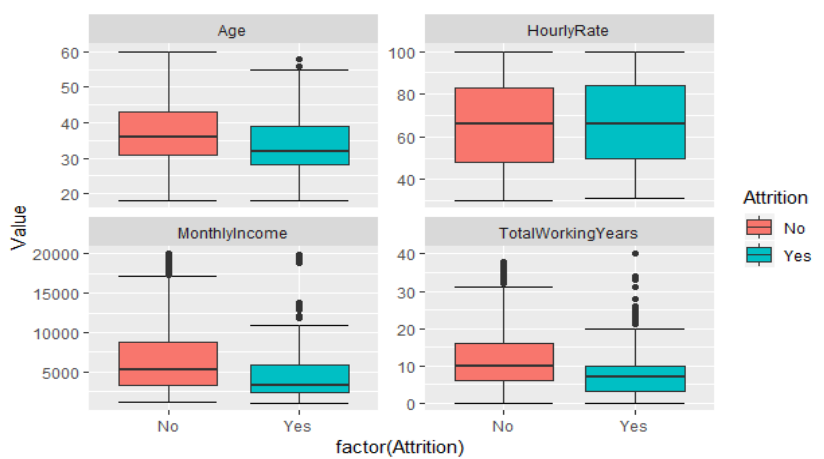
Box Plots and Bar Chart
Proportion of those with 'loyal' employees is higher
Further analysis on Decision tree variables.

Slide 16
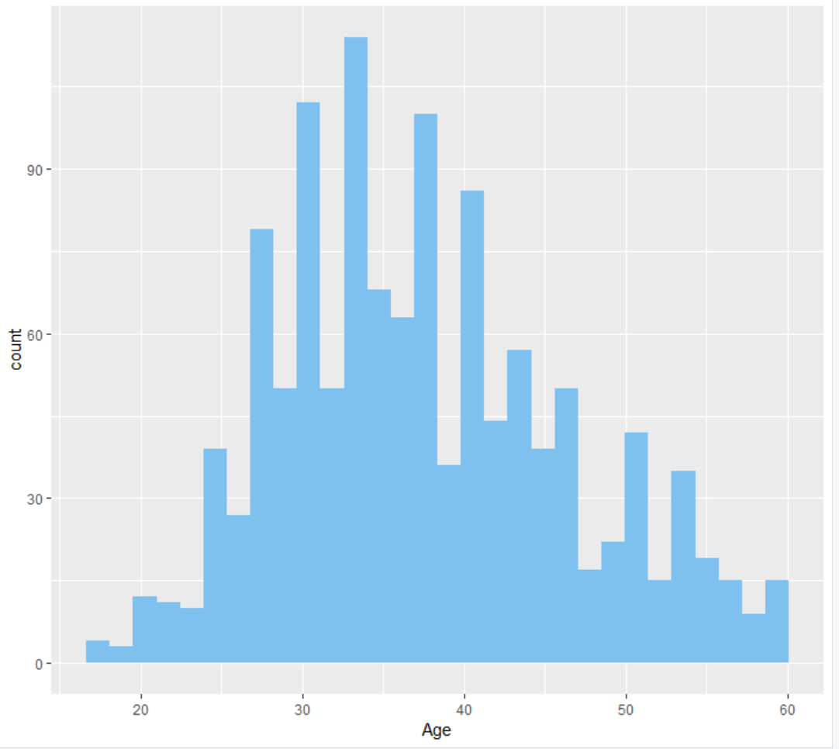
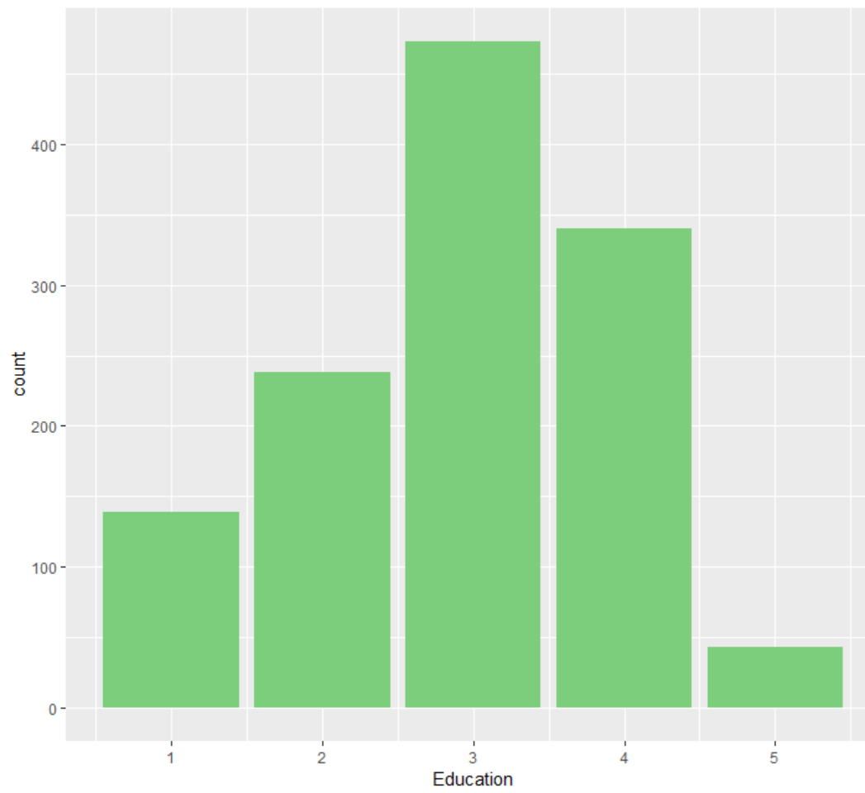
Dissecting high risk and loyal employees per attrition
Age
Mean age of 37, right skewed
Mean of ~ 3 for education level
Years since last promotion / 2.234388 against 1.95
Education

Slide 17
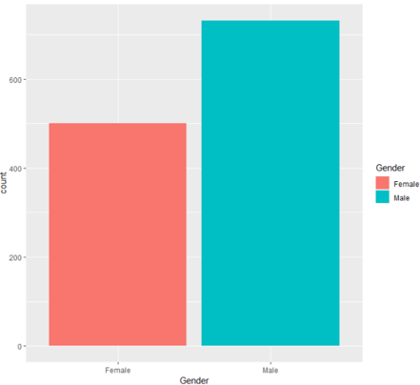

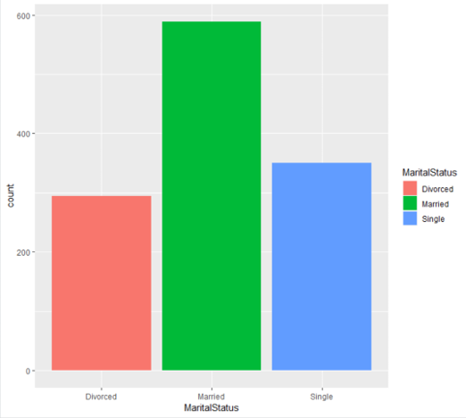
What does the average high risk employee look like?
Want to retain? Refrain from this guy.
Gender
Profile
Middle age / 37
College education / holds Bachelors
Married
Male
Low income
Less work experience
Swipe left? Not necessarily. We noticed averages were around the same for loyal and non-loyal employees. However the distributions were not the same, so while a loyal employee and non-loyal may share the same mean, one may only reflect similar means because of large outliers and the volume of the loyal employees skews our data.
Profession
MaritalStatus
Sales or Lab Tech

Slide 18

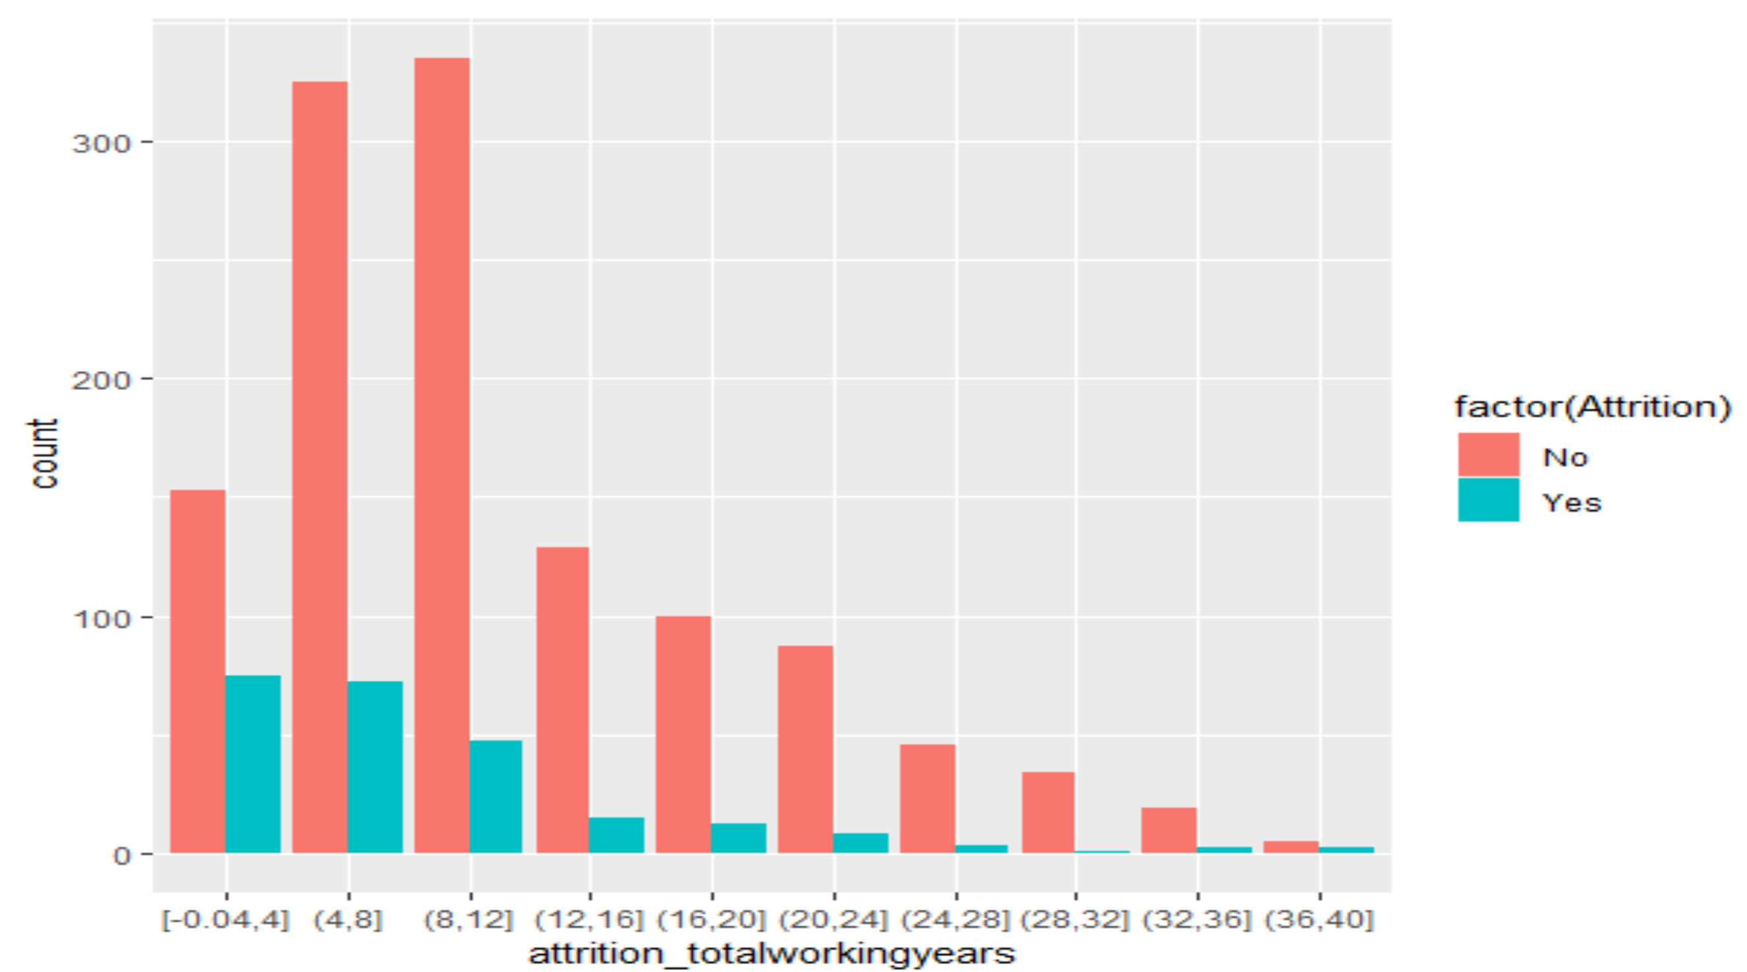
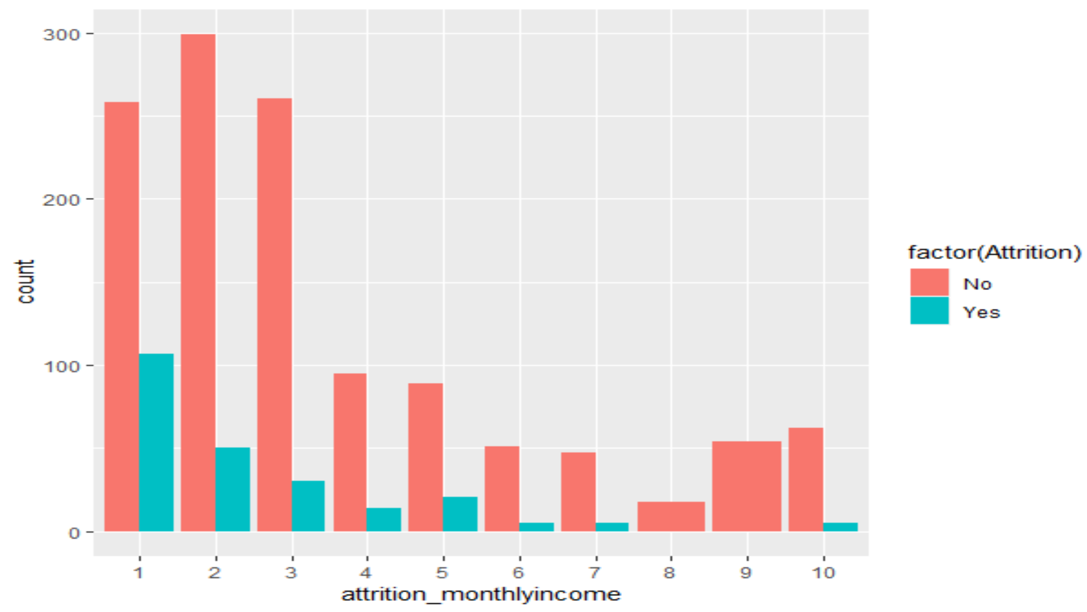
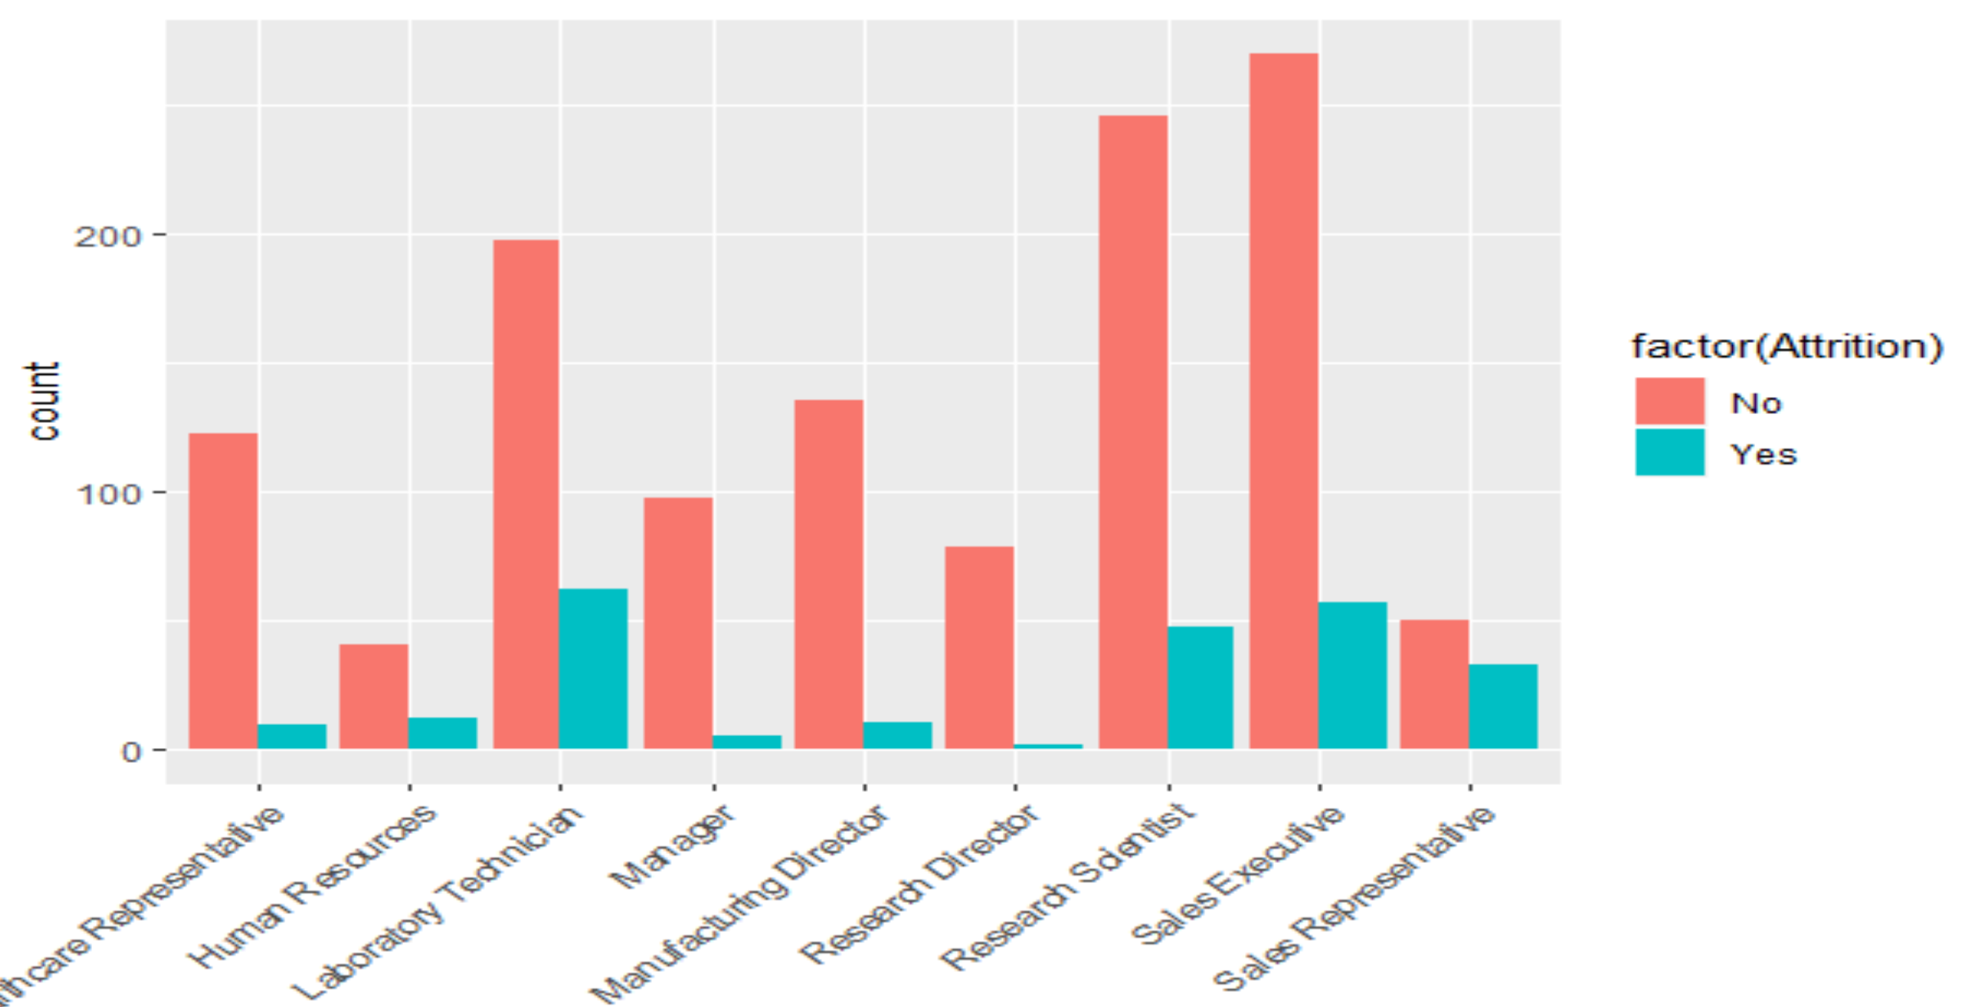
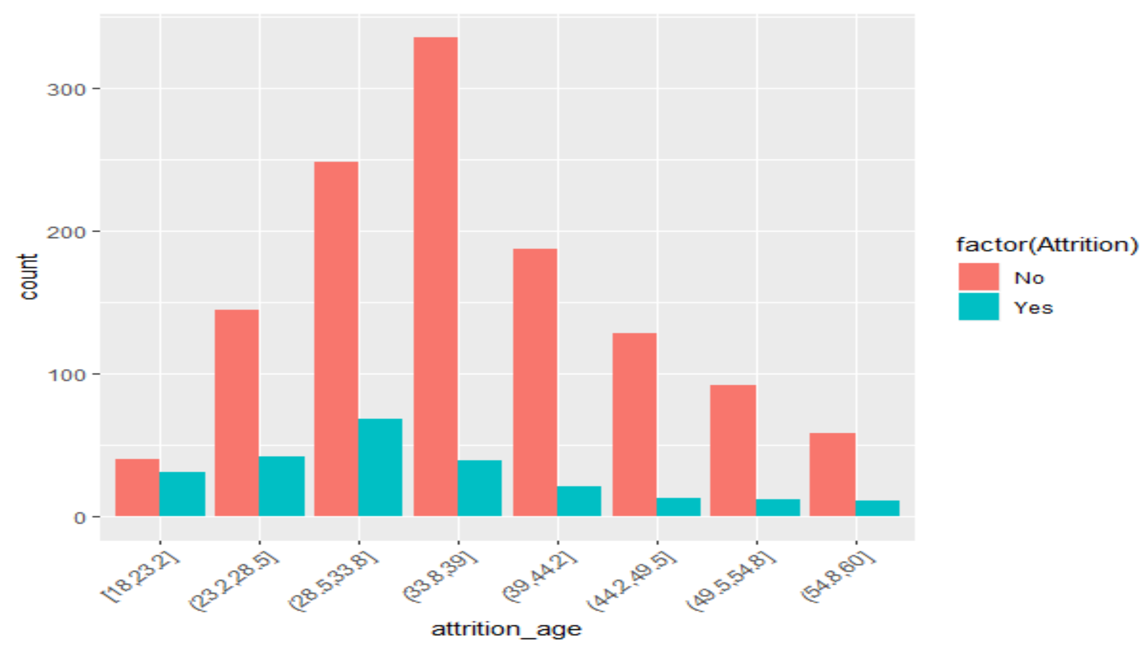
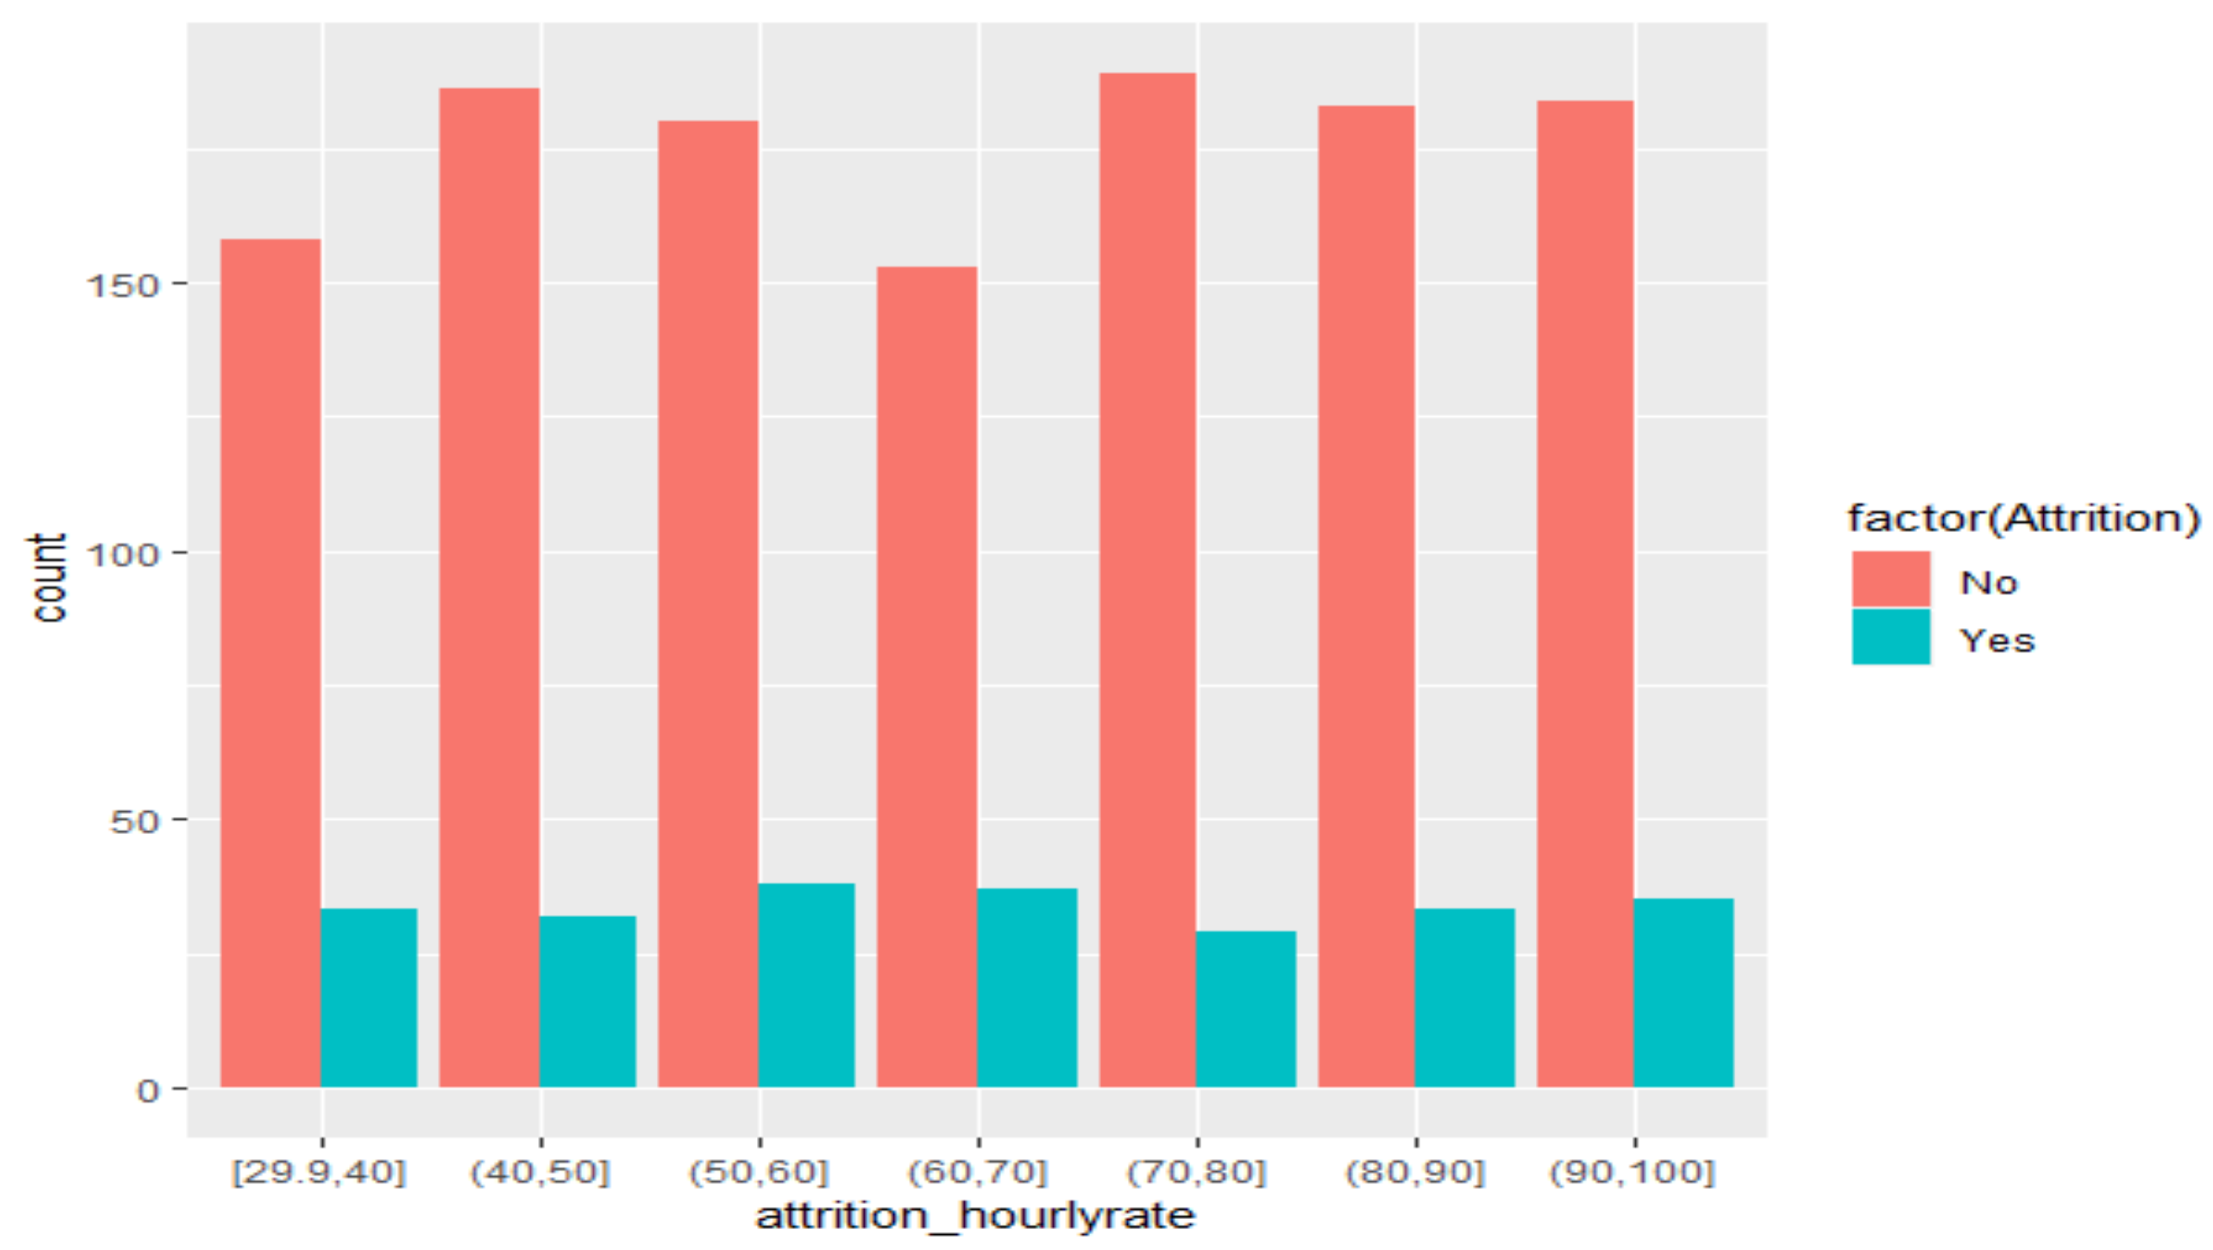
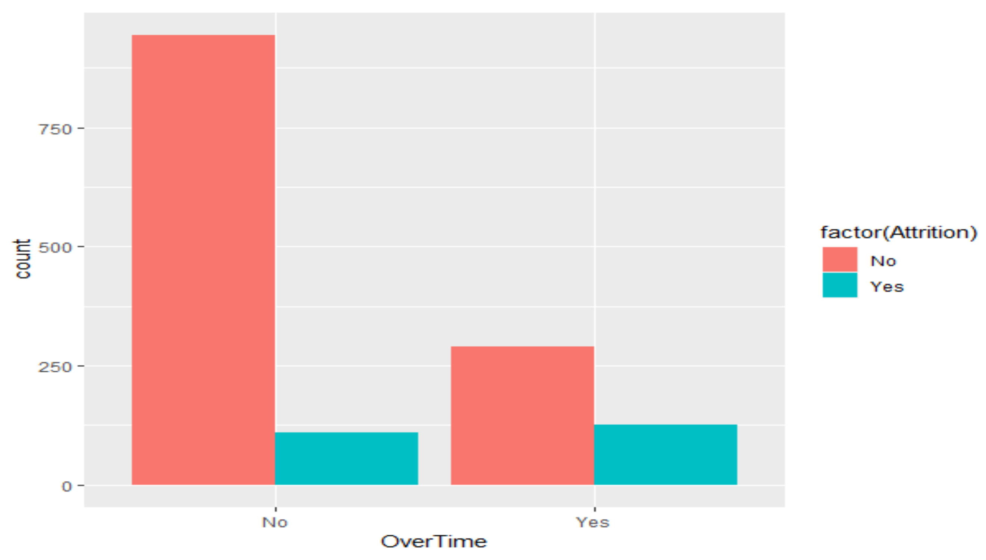
R plots of Top attrition factors
Low Monthly Income
Higher attrition
Low Total Working Years
Higher attrition
Laboratory Tech and Sales Execs have highest attrition Job role

Slide 19

What can we do better?
Areas of focus
Younger employee's (20-40) are your at-risk age range for attrition.
Older employees are more complacent/satisfied and need less incentive.
Extra training/incentive may help improve attrition amongst R&D and Sales representative.
Be wary of overtime as it’s a major contributor to attrition
Focus on R&D and Sales are more at risk
As they also do more overtime consider flex time and vacation
Free coffee is always welcome

Slide 20

Conclusions
Each Method of Analysis yielded similar results as to what is the highest attrition factor.
Monthly Income
Total Working Years
Overtime
Age
Job Role
Large number of employee Turnover due to Overtime
Job Roles to Watch
Laboratory Technician
Research Scientist
Sales Executive
Sales Representative
Interesting that those who invent and those who sell the product have the highest turnover.

Slide 21
Conclusions
Younger emloyee's harder to retain.
It is important to remember that even giving employees excellent pay and other perks won’t guarantee retention. Factors that are harder to quantify can play a factor.

Slide 22




Thank You
Team Tam
+1 555 867 9305
TeamTam@www.ddsanalytics.com
www.ddsanalytics.com

